Slide 1

DROWSY DRIVER DETECTION USING MACHINE LEARNING
Technical Seminar
by
Vishak V Kotemane | 221039002
Sandesh B S | 221039004
Under the guidance of
Dr. Mohan Kumar J
Associate Professor
Manipal School of Information Science

Slide 2
Presentation Outline
Introduction
2. Objective
Methodology
Literature Review
Block Diagram
6. Completed Work
7. Inference
8. References

Slide 3
1. Introduction
Serious accidents are frequently caused by driver fatigue and microsleep. However, the early symptoms of weariness can be recognized before a serious problem develops. Real-time drowsiness detection is a basic solution for this problem.
Driver drowsiness is alerted using real-time image processing using open cv and python.

Slide 4
2. Objectives
1. To learn the drowsy driver image concepts and OpenCV.
2. To implement an algorithm for drowsy driver detection using OpenCV.
3. To implement a machine learning model to identify the drowsy driver.
4. Database to store timestamps of “closed eye”.

Slide 5
3. Methodology
VIOLA-JONES ALGORITHM:
The program examines numerous tiny subregions of an image (this technique works on a grayscale image) and attempts to identify a face by looking for particular traits in each subregion. Due to the possibility of an image containing numerous faces of varied sizes, numerous places and scales must be checked. In their approach, Viola and Jones exploited Haar-like properties to find faces.
Haar-like features are digital image features used in object recognition. All human faces share some universal properties of the human face. The eye region is darker than its neighbor pixels, and the nose region is brighter than the eye region.
Input Image
Integral Image
Haar-Feature Selection
AdaBoost classifier
Cascading decision
Figure 1: Viola Jones algorithm

Slide 6
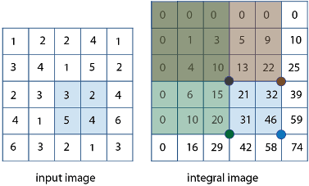
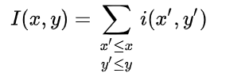
Integral image
A summed-area table is a data structure and algorithm for quickly and efficiently generating the sum of values in a rectangular subset of a grid.
where I(x,y) is the value of the pixel at (x,y).
(a)
(b)
Figure 2: (a)Input image (b) Integral image

Slide 7
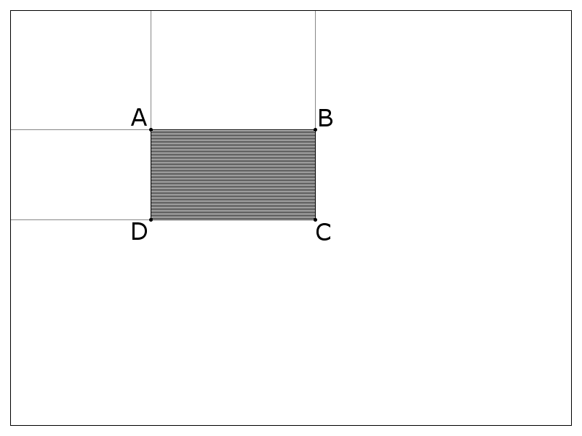
SELECTING HAAR-LIKE FEATURES:
A Haar-like feature considers adjacent rectangular regions at a specific location in a detection window, sums up the pixel intensities in each region, and calculates the difference between these sums. This difference is then used to categorize subsections of an image.
Sum = I(C) + I(A)-I(B)-I(D)
, where points A, B, C, and D belong to the integral image I, as shown in the figure.
Figure 3: Finding sum of shaded region

Slide 8
AdaBoost Classifier:
AdaBoost is used during the training phase of the Viola-Jones object detection algorithm to choose a subset of features and build the classifier.
A vast collection of photos is created, whose dimensions match those of the detection window.
Both positive and negative examples for the desired filter (such as just front views of faces) must be included in this set (nonfaces).

Slide 9
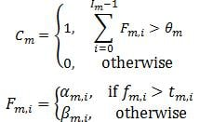
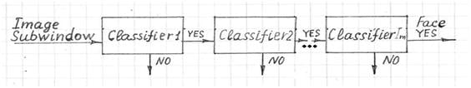
Cascading decision:
The classifier decision is defined as:
f_{m,i} is the weighted sum of the 2-D integrals. is the decision threshold for the i-th feature extractor. α_{m,i} and β_{m,i} are constant values associated with the i-th feature extractor. θ_{m} is the decision threshold for the m-th classifier.
Figure 4: Object detection via Viola Filter

Slide 10
4. Literature Review
Paper [1]:
In this experiment large number of videos were taken and their accuracy in determining eye blinks and drowsiness was tested.
When the webcam backlight was turned ON and the face is kept at an optimum distance, then the system is able to detect blinks as well as drowsiness with more than 95% accuracy
Paper [2]:
the program can detect the face region, eye region, and open eye region.
When the eyes are closed, the open eye region is not detected, which returns zero.
Alcohol sensor was also used.
Paper [3]:
Haar Cascade is used with Adaboost training, a machine learning adaptive algorithm to improve the accuracy and performance of the system.
This experiment has been done with Raspberrypi, Harr classifier cascades, and Circle Hough Transform in OpenCV.

Slide 11
1)Raspberry pi block diagram:
Webcam on(pi camera)
Motor control(slow down vehicle)
eyes==0>20secs
Harcascade feature detection
Time>20
State of eyes(3 frames)
Eyes==0
Save Screenshot of “closed eye” state
Eyes==1
continue
Timestamp database entry
Figure 5: Block diagram for Raspberry pi state detection
Sound buzzer

Slide 12
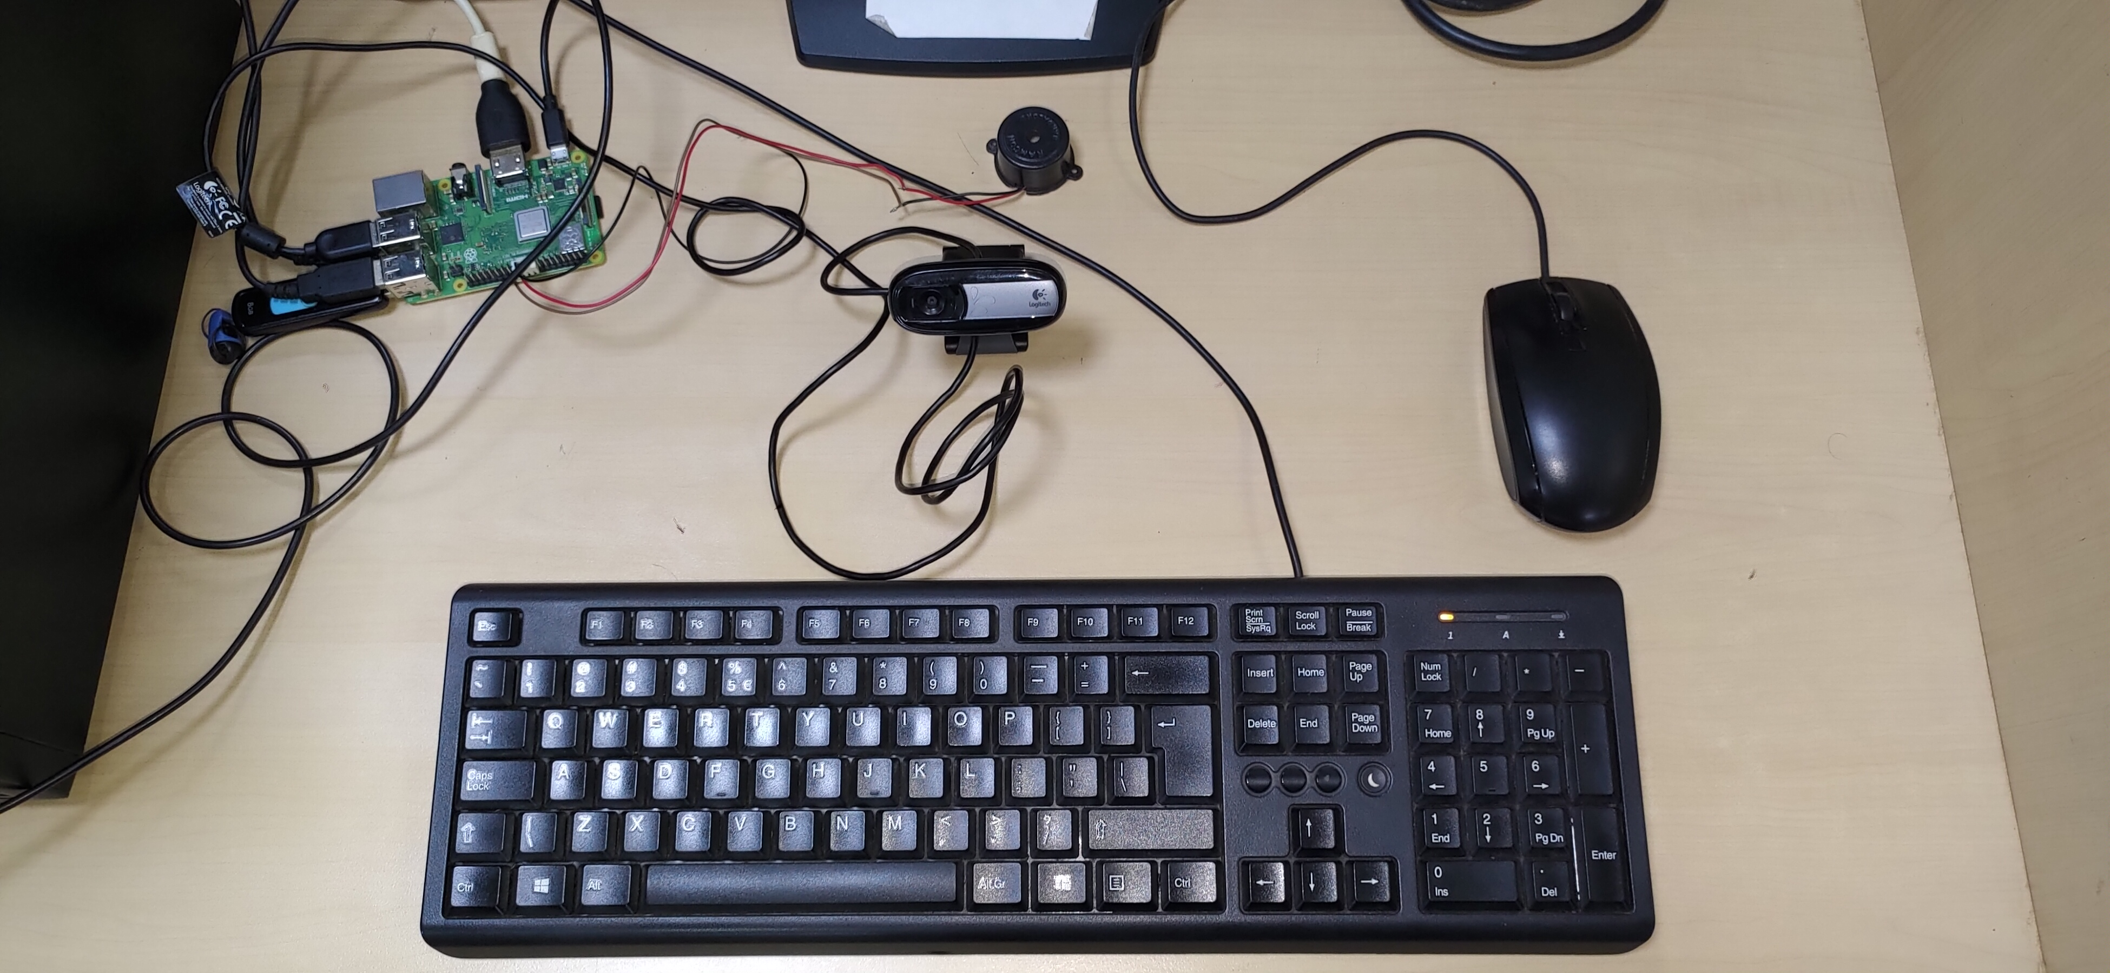
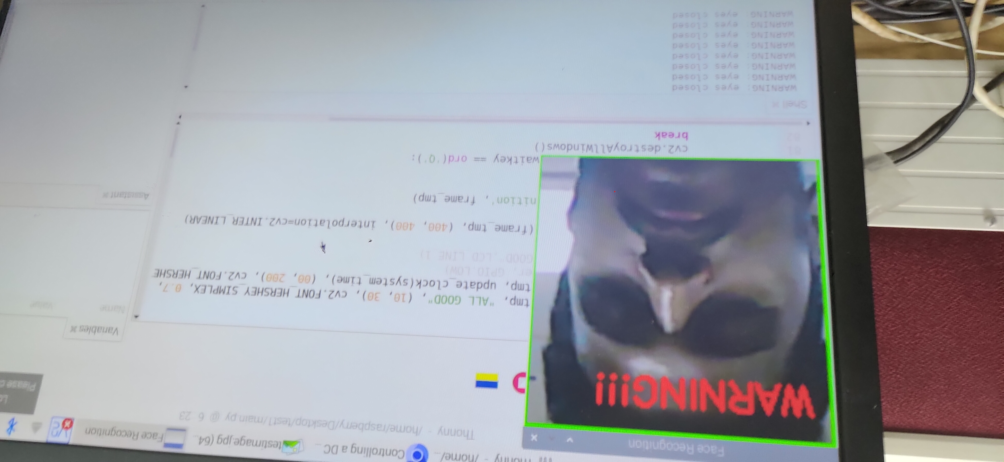
1) Raspberry pi simulation result:

Slide 13
Sqlite3 database:
SQLite is a C library that provides a lightweight disk-based database that doesn’t require a separate server process and allows accessing the database using a nonstandard variant of the SQL query language.
Steps to create a sqlite database:
First, we need to create a new database and open a database connection to allow sqlite3 to work with it. Call sqlite3.connect() to to create a connection to the database tutorial.db in the current working directory, implicitly creating it
In order to execute SQL statements and fetch results from SQL queries, we will need to use a database cursor. Call con.cursor()
Now that we’ve got a database connection and a cursor, we can create a database table.Execute the CREATE TABLE statement by calling cur.execute(...).
Add two rows of data supplied as SQL literals by executing an INSERT statement,
Call con.commit() on the connection object to commit the transaction

Slide 14
5. Block Diagram
2)Webcam block diagram:
Webcam on
Save Screenshot of “closed eye” state
Harcascade feature detection
State of eyes(3 frames)
Timestamp database entry
Eyes==0
Sound alarm
Eyes==1
continue

Slide 15
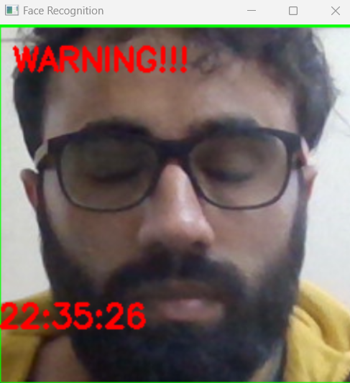
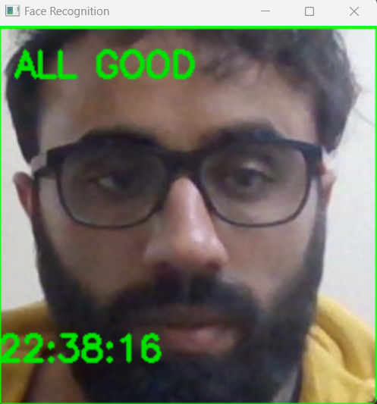
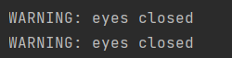
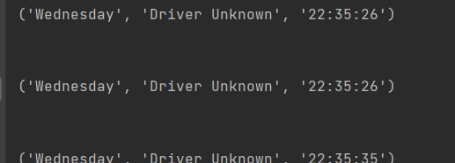
6. Completed Work
2) Webcam simulation results:
Figure 6: Detection of face successful
Figure 7: code output for closed eyes

Slide 16
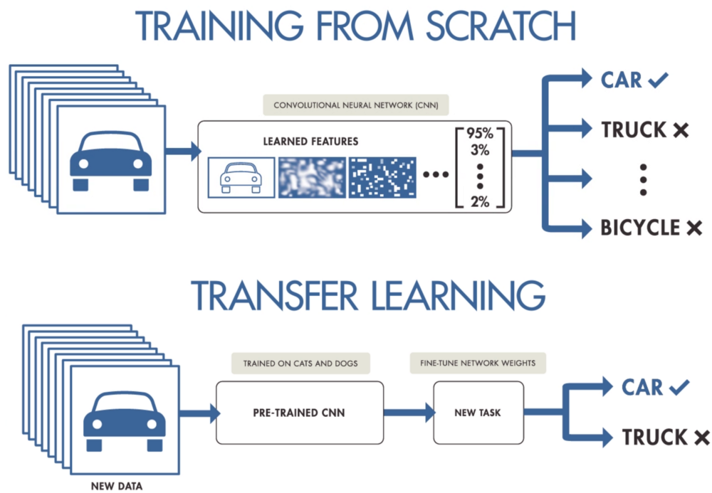
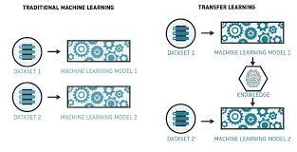
Transfer learning
Transfer learning is a machine learning method where a model developed for a task is reused as the starting point for a model on a second task.
Keywords used:
1) one epoch = one forward pass and one backward pass of all the training examples
2) batch size = the number of training examples in one forward/backward pass. The higher the batch size, the more memory space you'll need.

Slide 17
Building and training a ML model:
Raw Data
Apply pre-processing to data
Testing set
Prepared Data
Training set
Apply learning algorithm to data
Find best model
User model
Deploy model
Applications

Slide 18
Steps used to build a ML model:
1) Collect data for required classes.
2) Specify/Modify parameters of data:
eye = frame[ey:ey + eh, ex:ex + w] #pre-processing data
eye = cv2.resize(eye, (80, 80))
eye = eye / 255
eye = eye.reshape(80, 80, 3)
eye = np.expand_dims(eye, axis=0)
3) Apply machine learning algorithm(Keras-InceptionV3)
4) Iterate till best model found
5) Choose the model for deployment.

Slide 19
3) ML model based prediction:
Webcam on
Harcascade feature detection
Save Screenshot of “closed eye” state
Eye feature extract and store to variable
Timestamp database entry
Model predication
< 0.30
Sound alarm
Display “eyes open”
Eyes==1
continue

Slide 20
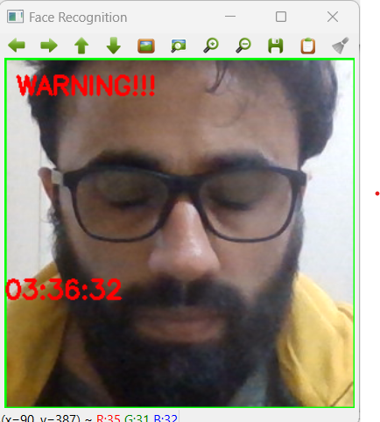
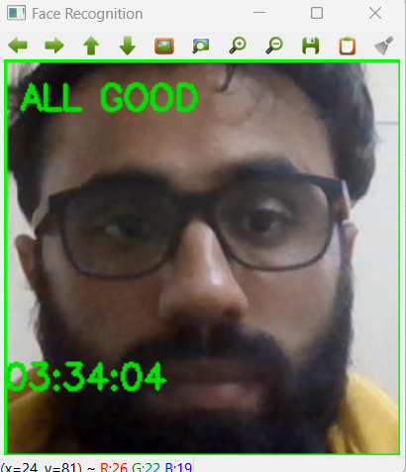
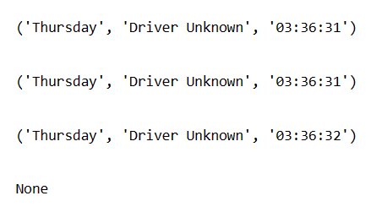
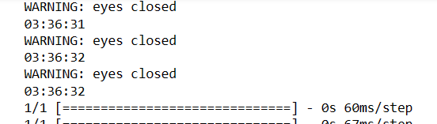
3) ML model implemention result:
Database entry:
Console output:

Slide 21
7. Inference
The driver's eyes are located, monitored, and used to quickly detect tiredness as part of the real-time drowsiness detection system.
This method enables the machine to recognize closed eyes (sleep condition).
After determining the sleep condition, the real-time system sounds the alarm as a warning.
A database is used to stored the timestamps of closed eye state and takes the screenshot and save the sleep state as a jpg file(may be used as for new dataset/ImageNet).
The implementation of an machine learning model, increases the accuracy of detection.

Slide 22
8.References
Danisman, T., Bilasco, I.M., Djeraba, C. and Ihaddadene, N., 2010, October. Drowsy driver detection system using eye blink patterns. In 2010 International Conference on Machine and Web Intelligence (pp. 230-233). IEEE.
Sarkar, D. and Chowdhury, A., 2014. A real time embedded system application for driver drowsiness and alcoholic intoxication detection. International Journal of Engineering Trends and Technology, 10(9), pp.461-465.
Musale, T. and Pansambal, B., 2016. Real Time Driver Drowsiness Detection system using Image processing. Research in Engineering Application & Management (IJREAM), 2(08).

Slide 23
Queries
&
Suggestions

Slide 24
THANK YOU…

